Slide 1
Lithuania and english breakfast
Gytis Grižas 8c

Slide 2
Content
English breakfast
Lithuania breakfast

Slide 3
introduction
this project about two different countries breakfast

Slide 4
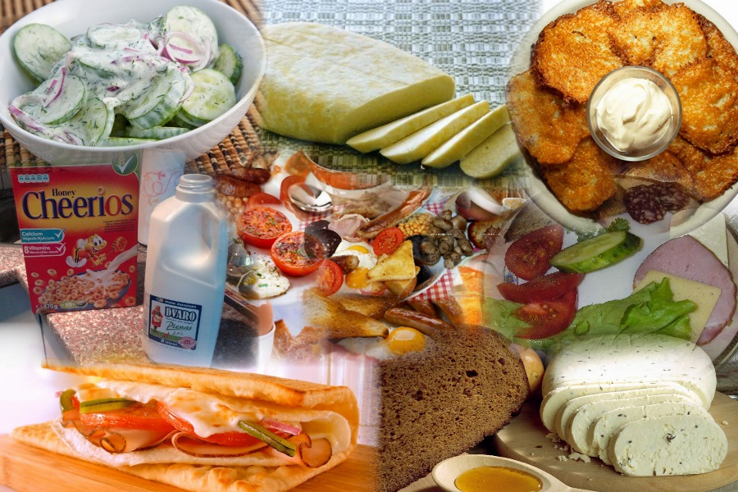
Lithuania Breakfast

Slide 5
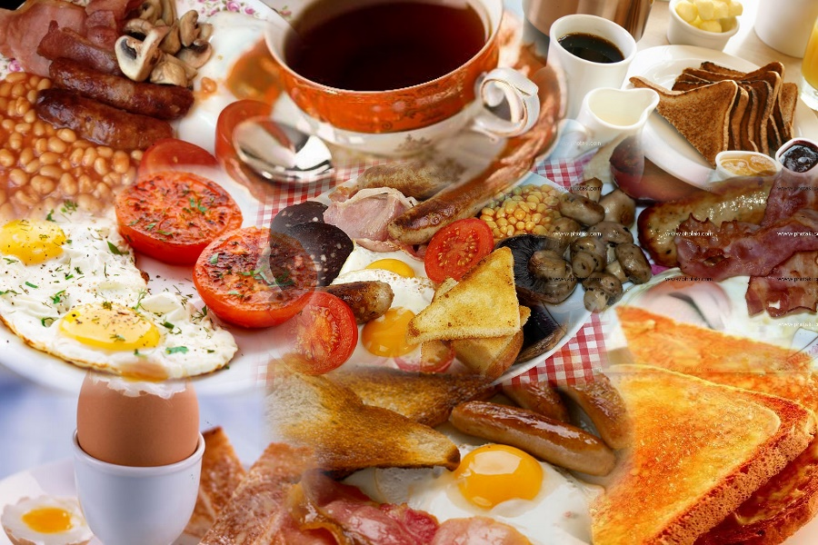
English Breakfast

Slide 6
English breakfast
1.Bacon
2.Sausages
3.Mushrooms
4.Fried eggs
5.Beans
6.Tomatoes

Slide 7
Lithuania breakfast
Lithuania doesn‘t have traditcional breakfast but they usualy eat :
Sandwiches with sausages and butter
Fried eggs with bread

